Slide 1
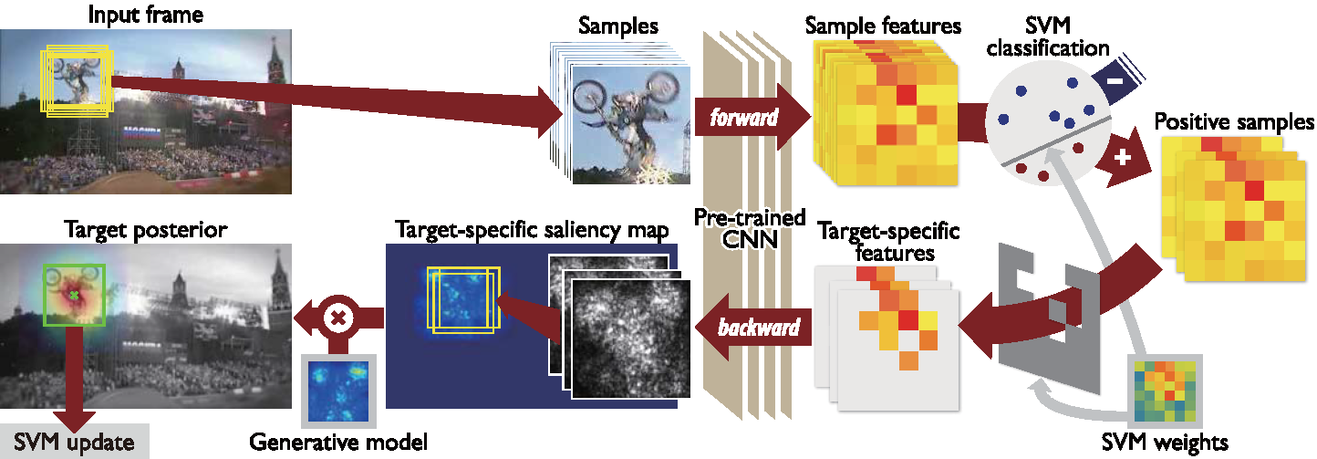
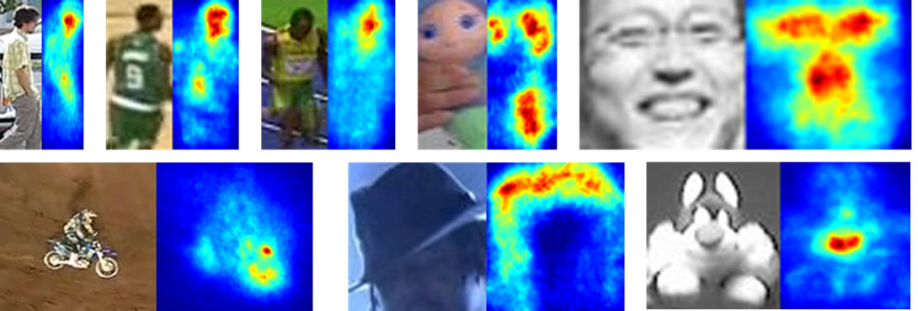
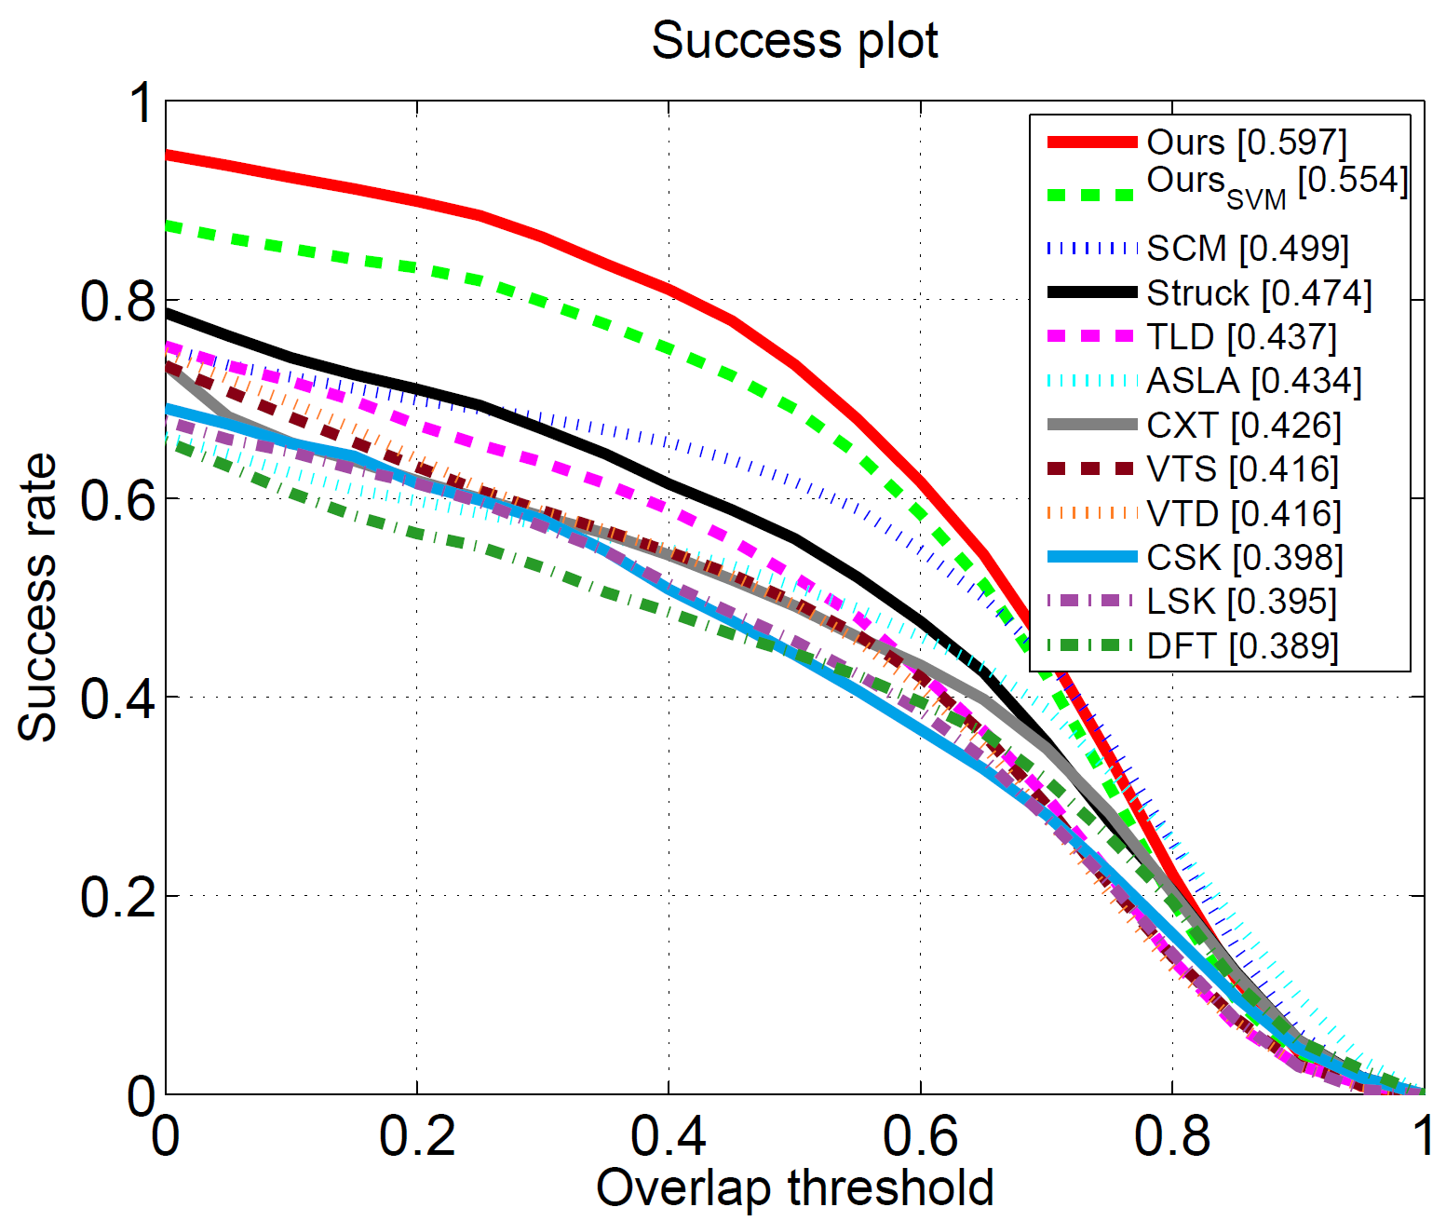
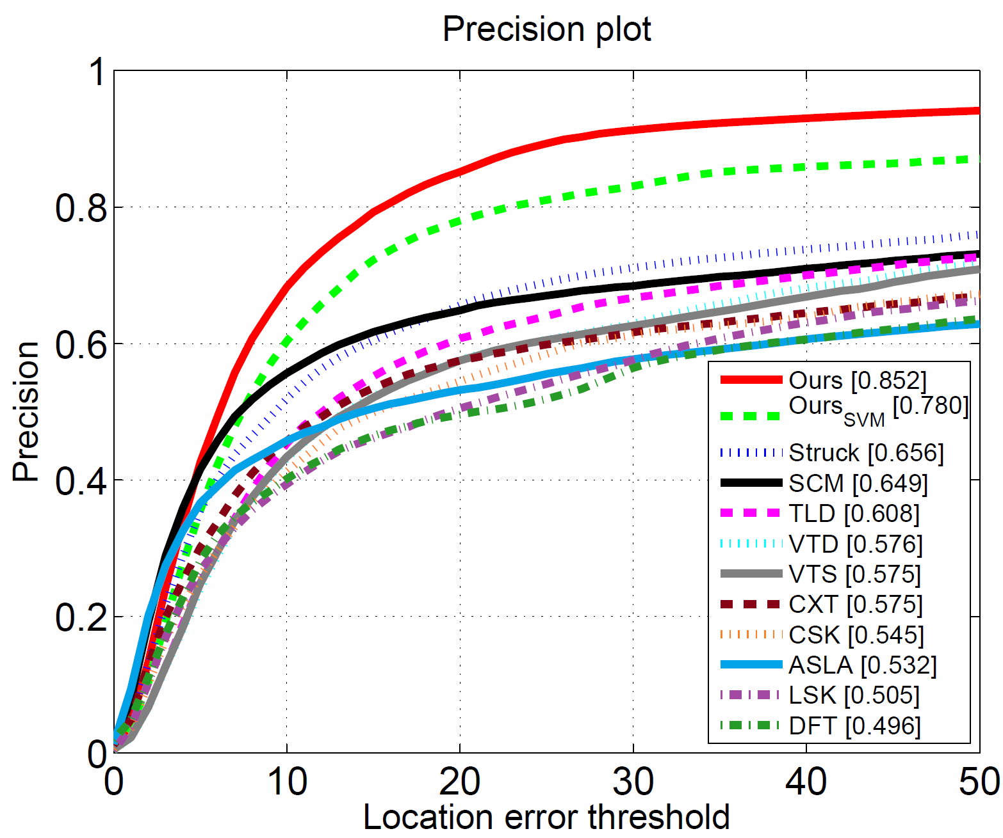
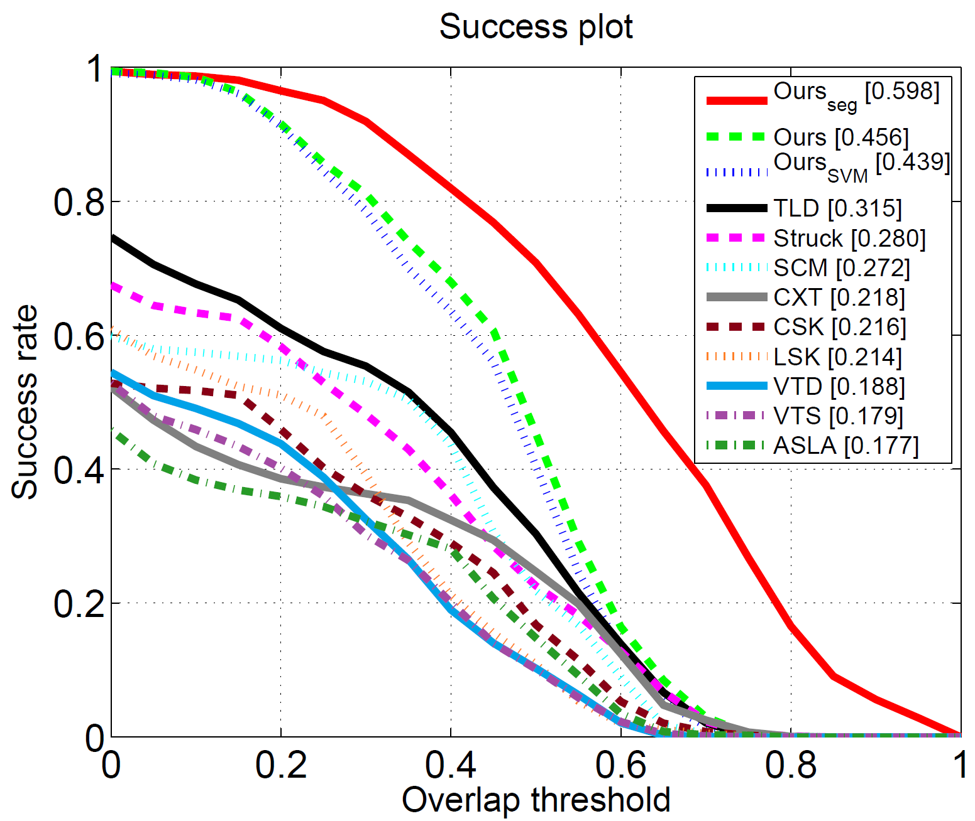
Online Tracking by Learning Discriminative Saliency Map
with Convolutional Neural Network
Seunghoon Hong¹, Tackgeun You¹, Suha Kwak², Bohyung Han¹
¹Dept. of Computer Science and Engineering, POSTECH
²INRIA - WILLOW Project team
Problem
1. Pre-trained CNN for feature descriptor
2. Target-specific saliency map estimation
Using a pre-trained CNN to represent a general object in visual tracking
Base network: R-CNN^{[Girshick14]} pre-trained with PASCAL VOC images
Class-specific saliency map^{[Simonyan14]}
Advantage: CNN provides strong target representation robust to various appearance changes.
Input: sub-image $z_{i}$ extracted from each target candidate proposal $x_{i}$
Identify relevance of pixels w.r.t specific class by
output: outputs from the first fully-connected layer ${φ(x}_{i})$
$$g_{c}\left(I\right)= \frac{∂S_{c}(I)}{∂I}$$
$I$ : input image
$S_{c}(I)$: score of class c
Limitation: CNN feature is not appropriate for precise localization due to spatial abstraction.
Problem: No predefined class for target in tracking
Our approach: Compute target-specific saliency map as observation for tracking.
Target-specific saliency map
Online SVM as the last fully-connected layer of the network
4. Model update
Generative model: temporal sliding of target filters
$$H_{t}=H_{t−1}−M_{t−m}+M_{t}$$
$$g_{FG}\left(z_{i}\right)= \frac{∂S_{FG}(z_{i})}{∂z_{i}}={\left(w^{+}\right)}^{T}\left(\frac{∂φ(x_{i})}{∂z_{i}}\right)=\frac{∂φ^{+}(x_{i})}{∂z_{i}}$$
Discriminative model: Update incremental SVM with new examples $\{\left(x_{i}′,y_{i}′\right)\}$
$$y_{i}^{′}=\left\{\begin{matrix}+1, if x_{i}^{′}=x_{t}^{∗} \\ −1, if \frac{BB\left(x_{t}^{∗}\right)∩BB\left(x_{t}^{′}\right)}{BB\left(x_{t}^{∗}\right)∪BB\left(x_{t}^{′}\right)}<δ\end{matrix}\right.$$
3. Target localization with saliency map
Then compute the target-specific saliency map $M$ by
Localization by sequential Bayesian filtering
Computing target specific feature
$$x_{t}^{∗}=\underset{x_{t}}{argmax}{ p\left({ x}_{t} \right| M_{1:t} )=\underset{x_{t}}{argmax} p\left(M_{t} | x_{t}\right)p(x_{t}|M_{1:t−1}) }$$
$$φ_{k}^{+}\left(x_{i}\right)=\left\{\begin{matrix}{w_{k}φ}_{k}\left(x_{i}\right), if w_{k}>0 \\ 0, otherwise\end{matrix}\right.$$
Target segmentation
Construct generative model $H_{t}$ by accumulating $m$ recent tracking results on saliency map
Compute likelihood by convolution
Computing gradient map $g_{FG}\left(z_{i}\right)$ by back-propagating $φ_{k}^{+}\left(x_{i}\right)$
Aggregating sample gradient maps
Employing GrabCut^{[Rother04]} on saliency map
$$p\left(M_{t} | x_{t}\right)∝H_{t}⊗M_{t}\left(x_{t}\right)$$
Examples of obtained target-specific saliency map
Given tracking result, select FG/BG seeds based on saliency value
Quantitative results
Evaluation based on bounding box (1,2) and segmentation (3) ground-truth
Qualitative results
1
2
3
Examples of obtained target-specific saliency maps

