Slide 1
Visual Tracking by Sampling Tree-Structured Graphical Models
Seunghoon Hong
Bohyung Han
Computer Vision Lab.
Dept. of Computer Science and Engineering
POSTECH

Slide 2
Goal of Visual Tracking
Robust estimation of accurate target states throughout an input video

Slide 3
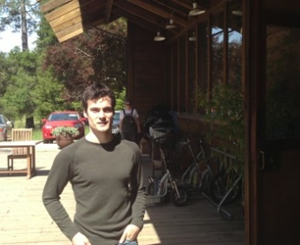
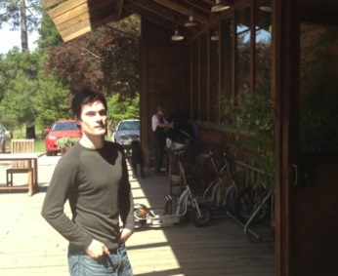
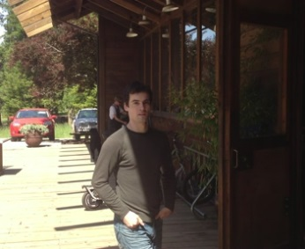
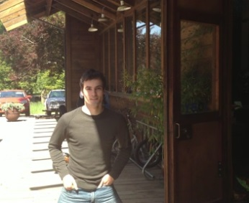
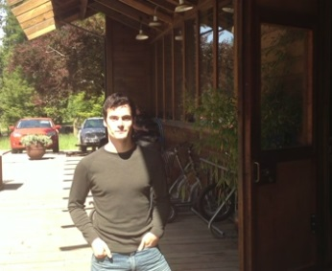
Conventional Tracking Approaches
Sequential tracking based on chain model
1
15
30
60
75
1
15
30
60
75

Slide 4
Orderless Tracking^{[HongICCV2013]}
Orderless tracking based on Bayesian model averaging
1
15
30
60
75
1
75
15
60
30
[HongICCV2013] S. Hong, S. Kwak and B. Han. Orderless Tracking through Model-Averaged Posterior Estimation. In ICCV, 2013

Slide 5
Orderless Tracking^{[HongICCV2013]}
Orderless tracking based on Bayesian model averaging
Multiple propagations
1
75
15
60
30
Non-relevant frames
Target variation
Advantages:
Robust to error propagation
Limitation:
Ineffective to handle multi-modal variation
[HongICCV2013] S. Hong, S. Kwak and B. Han. Orderless Tracking through Model-Averaged Posterior Estimation. In ICCV, 2013

Slide 6
Our Approach
Tracking on tree-structured graphical model
1
15
30
60
75
60
30
1
75
15

Slide 7
Tracking on Tree-Structure
1
1
1
1
Advantages
1. Multi-modality is handled by independent branch
75
75
75
9
75
9
9
9
2. Failures are isolated at local branch
15
15
15
15
30
15
30
30
60
30
60
60
60
3. Frames are ordered based on tracking difficulty
132
132
132
116
132
116
116
116
67
67
67
84
67
84
84
84

Slide 8
Challenges
Tree learning and tracking are mutually dependent
1
2
3
4
5
Which tree is good for tracking?
1
1
1
1
2
3
2
5
4
5
4
5
3
5
3
3
2
4
4
2

Slide 9
Our Approach
Joint tree learning and tracking based on sampling
$$\hat{G}=\underset{G^{l}}{argmin}−\log{p(}𝒴^{l}\left|G^{l}\right),$$
$$l=1,…,M$$
A
$$G^{1}$$
A
$$G^{2}$$
$$G^{M}$$
A
B
B
C
B
C
F
C
D
E
D
F
E
D
F
E
Tracking
Sampling
Tracking
Sampling
Tracking
$$𝒴^{1}$$
$$𝒴^{2}$$
$$𝒴^{M}$$

Slide 10
Sampling Tree Structure by MCMC
Optimization by MCMC sampling
Propose a new sample by proposal distribution $Q\left(G^{l+1};G^{l}\right)$
Accept a new sample by acceptance ratio $α$
Acceptance step
Tracking
Proposal step
Tree sample $G^{l}$
Tracking result $𝒴^{l}$
Tree sample $G^{l+1}$
Tracking result $𝒴^{l+1}$
A
A
B
C
B
C
D
E
F
D
F
E
Iteration $l$
Tree quality
Iteration $l+1$

Slide 11
Challenges
How to propose a better tree?
How to measure the quality of tree for tracking?
Tree sample $G^{l}$
Tracking result $𝒴^{l}$
Tree sample $G^{l+1}$
Tracking result $𝒴^{l+1}$
A
A
B
C
B
C
D
E
F
D
F
E
Iteration $l$
Iteration $l+1$

Slide 12
Proposing A New Tree
Single edge delete/add operation
$$Q\left(G^{l+1};G^{l}\right)=P_{delete}∗P_{add}$$
$$P_{delete}\left(i,j\right)=\frac{\exp\left(d(i,j)\right)}{\sum_{\left(a,b\right)∈ℰ}{\exp\left(d\left(a,b\right)\right)}},$$
$$\left(i,j\right)∈ℰ$$
distance between target templates $d(i,j)$
$$d(a,b)$$
$$d(b,c)$$
$d\left(a,b\right)≪d(b,c)$
$$y_{a}$$
$$y_{b}$$
$$y_{c}$$
A
B
C
D
E
F
(a) edge deletion

Slide 13
Proposing A New Tree
Single edge delete/add operation
$$Q\left(G^{l+1};G^{l}\right)=P_{delete}∗P_{add}$$
$$P_{delete}\left(i,j\right)=\frac{\exp\left(d(i,j)\right)}{\sum_{\left(a,b\right)∈ℰ}{\exp\left(d\left(a,b\right)\right)}},$$
$$\left(i,j\right)∈ℰ$$
$$P_{add}\left(i,j\right)=\frac{\exp\left(−d(i,j)\right)}{\sum_{\left(a,b\right)∈\overline{ℰ}}{\exp\left(−d\left(a,b\right)\right)}},$$
$$\left(i,j\right)∈\overline{ℰ}$$
C
A
D
B
D
A
B
C
D
E
F
A
E
E
B
C
F
F
(a) edge deletion
(b) edge addition
(c) edge reversing

Slide 14
Validating A New Tree
Accept a new tree structure
by measuring quality of the tree for tracking
$$=\sum_{i}{c_{i}=\sum_{i}{max⁡(d\left(i,p_{i}\right),c_{p_{i}})}}$$
$$−\log{p(}𝒴^{l}|G^{l})$$
$$G^{l+1}$$
1
tracking cost
$$d(i,j)$$
15
15
$$y_{i}$$
$$y_{j}$$
2
45
45
Accumulated cost $$c_{i}=\max{(d\left(i,p_{i}\right),c_{p_{i}})}$$
3
6
45
5
45
5
4
5
Error propagation by accumulated cost
45
11

Slide 15
Validating A New Tree
Accept a new tree structure
With an acceptance ratio $α$
Tree energy over MCMC iterations
$$α=\min\left[ 1, \frac{[−\log{p(}𝒴^{l+1}{\left|G^{l+1}\right)]}^{−1}Q\left(G^{l};G^{l+1}\right)}{[ −\log{p(}𝒴^{l}{\left|G^{l}\right) ]}^{−1}Q\left(G^{l+1};G^{l}\right)}\right]$$
Tree energy decreases fast

Slide 16
Tracking on Tree Structure
Density propagation in tree structure
Tree structure $G^{∗}$
Density propagation by sequential Bayesian filtering
$$x_{1}$$
$$x_{1}$$
$$x_{1}$$
$$x_{1}$$
$$p\left(x_{t} | {\left\{z_{i}\right\}}_{i=1,…,t},G\right)∝p\left(z_{t} | x_{t}\right) \int_{x_{p_{t}}}{p\left(x_{t} | x_{p_{t}}\right)p\left(x_{p_{t}} | {\left\{z_{i}\right\}}_{i=1,…,p_{t}},G\right)dx_{p_{t}}}$$
$$x_{2}$$
$$x_{2}$$
$$x_{2}$$
$$x_{4}$$
$$x_{2}$$
$$x_{4}$$
$$x_{4}$$
$$x_{4}$$
$$x_{p_{t}}$$
$$x_{p_{t}}$$
$$x_{p_{t}}$$
$$x_{5}$$
$$x_{p_{t}}$$
Observation at current frame $t$
Prediction from parent frame $p_{t}$
$$x_{5}$$
$$x_{5}$$
$$x_{5}$$
$$≈\sum_{x_{p_{t}}^{i}∈𝕊_{p_{t}}}{P\left(Z_{t} | x_{t}\right)P\left(x_{t} | x_{p_{t}}^{i}\right)}$$
$$x_{t}$$
Patch matching
and voting process^{[HongICCV2013]}
$$x_{t}$$
$$x_{t}$$
$$x_{t}$$
[HongICCV2013] S. Hong, S. Kwak and B. Han. Orderless Tracking through Model-Averaged Posterior Estimation. In ICCV, 2013

Slide 17
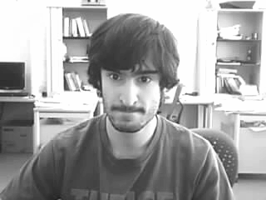
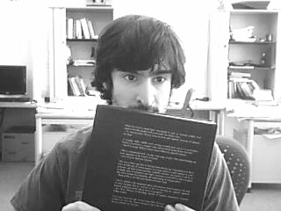
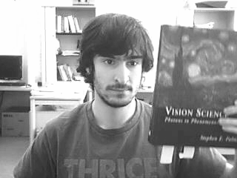
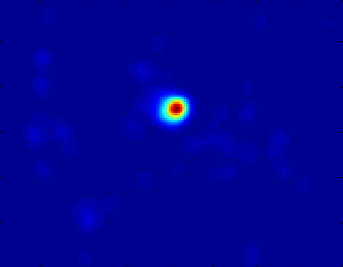
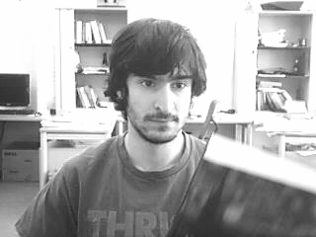
$$≈\sum_{x_{p_{t}}^{i}∈𝕊_{p_{t}}}{P\left(Z_{t} | x_{t}\right)P\left(x_{t} | x_{p_{t}}^{i}\right)}$$
Patch matching
and voting process^{[1],[2]}
Tree structure $G^{∗}$
Frame $p_{t}$
Frame $t$
$$x_{1}$$
$$x_{4}$$
$$x_{2}$$
$$x_{4}$$
Sample 1
Voting map by sample 1
Aggregated voting map
$$x_{p_{t}}$$
$$x_{5}$$
$$x_{p_{t}}$$
$$x_{5}$$
$$x_{t}$$
$$x_{t}$$
?
[1] S. Hong, S. Kwak and B. Han. Orderless Tracking through Model-Averaged Posterior Estimation. In ICCV, 2013
[2] S. Korman and S. Avidan. Coherency sensitive hashing. In ICCV, 2011

Slide 18
Identified Tree Structure
Multi-modal appearance change
145
141
135
145
141
137
135
132
127
122
137
132
127
122
152
152
67
70
67
70
156
28
156
28
6
1
6
1
16
24
16
31
24
31
84
159
20
84
159
20
9
9
162
44
162
44
64
64
171
94
171
94
38
167
38
167
<sunshade sequence>

Slide 19
Identified Tree Structure
Occlusion
103
111
128
138
150
85
94
27
1
76
72
63
56
47
39
118
174
<campus sequence>

Slide 20
Computational Complexity
Overall complexity : $O(MN)$
$M$ : number of iterations
$N$ : number of frames
Efficiency: posterior reusability
A
A
A
A
C
B
C
B
C
B
C
Unchanged part of tree
B
D
E
D
E
F
D
F
D
F
Modified subtree
F
E
E

Slide 21
Computational Complexity
Overall complexity : $O(MN)$
$M$ : number of iterations
$N$ : number of frames
Efficiency: posterior reusability
Tree modification near leaf nodes

Slide 22
Computational Complexity
Overall complexity : $O(MN)$
$M$ : number of iterations
$N$ : number of frames
Efficiency: posterior reusability
We can further reduce a theoretical bound by a hierarchical approach : $O(kM+N−k)$

Slide 23
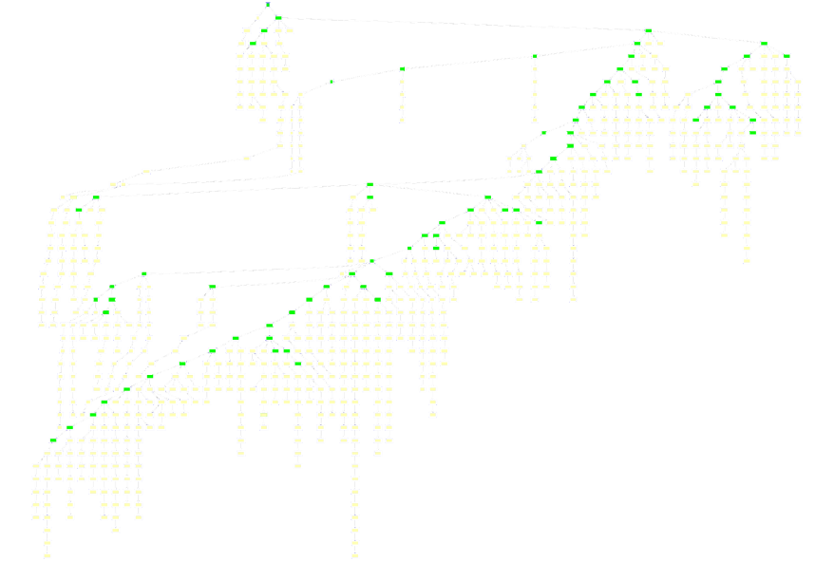
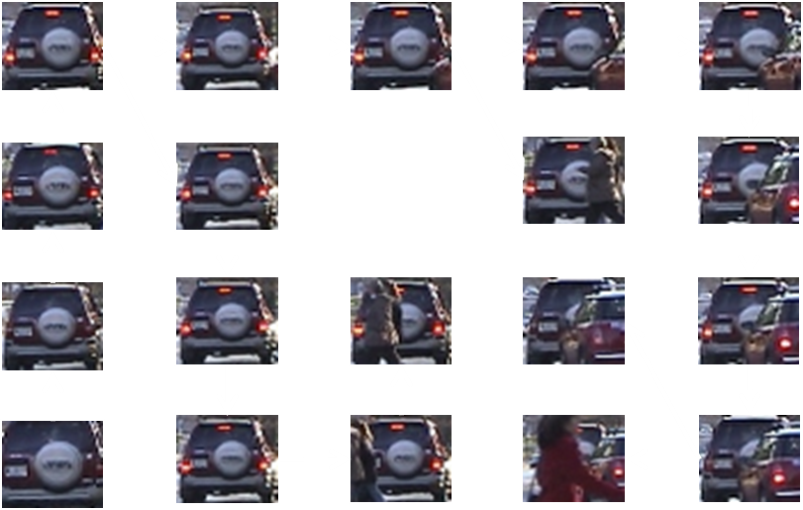
Hierarchical Approach
Original Video
Key frame selection
Tree extension to entire video and tracking on the tree
Tree construction for key frames

Slide 24
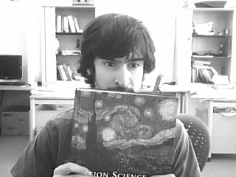
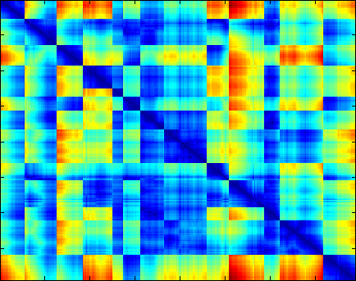
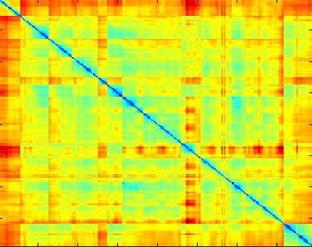
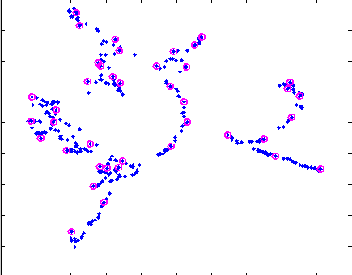
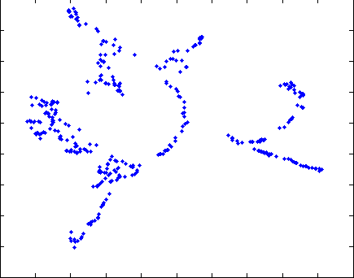
Key Frame Selection^{[HongICCV2013]}
ISOMAP
A metric space, $E$
Geodesic distances from a sparse nearest neighbor graph
Dissimilarities between all pairs of frames
Embedded frames
$k$ most representative frames obtained by a $k$-means clustering
$$\frac{1}{n_{1}}\sum_{P∈I_{1}}{\min_{Q∈I_{2}}{d(P,Q)}}+\frac{1}{n_{2}}\sum_{Q∈I_{2}}{\min_{P∈I_{1}}{d(P,Q)}}$$
[HongICCV2013] S. Hong, S. Kwak and B. Han. Orderless Tracking through Model-Averaged Posterior Estimation. In ICCV, 2013

Slide 25
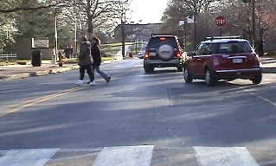
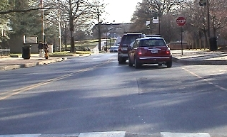
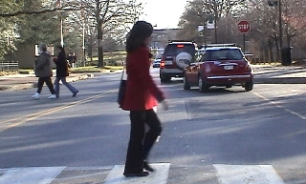
Tree Extension by Manifold Alignment
Key frames
?
Non key frames

Slide 26
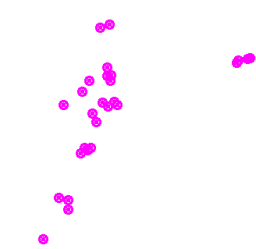
Tree Extension by Manifold Alignment
Entire frames
Key frames
Embedding based on scene distance
Embedding based on target distance

Slide 27
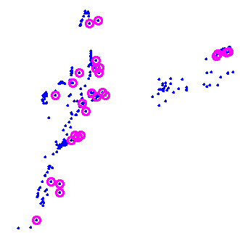
Tree Extension by Manifold Alignment
Tree extension by semi-supervised manifold alignment^{[3]}
$$\min_{s,t}{Φ\left(s,t\right)≡μ\sum_{i∈𝒦}{{\left|s_{i}−t_{i}\right|}^{2}+s^{T}L^{s}s+t^{T}L^{t}t}}$$
Scene based embedding $s$
Target based embedding $t$
Joint embedding
[3] J. Ham, D. Lee, L. Saul, Semisupervised alignment of manifolds. In 10th International Workshop on Artificial Intelligence and Statistics, 2005

Slide 28
Tree Extension by Manifold Alignment
Identified tree structures
: Key frames
: Non-key frames
<youngki sequence>

Slide 29
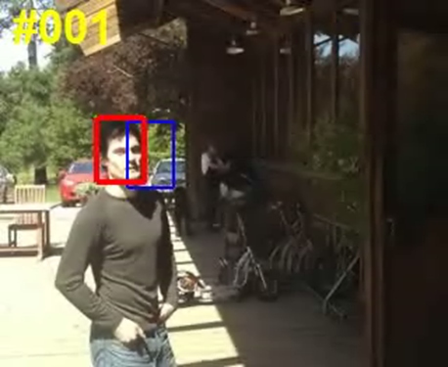
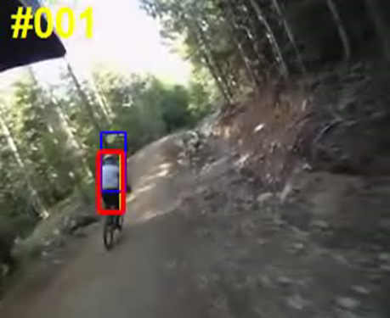
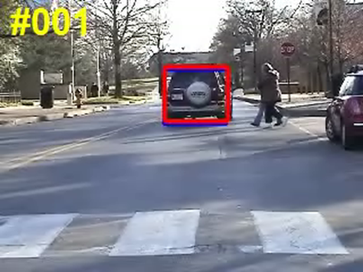
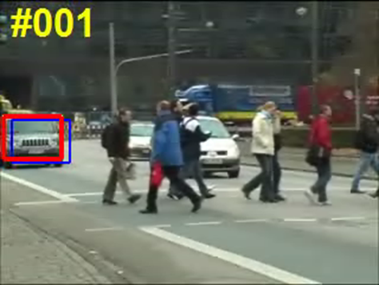
Qualitative Results
sunshade
bike
TUD
campus
OURS
WLMC
OTLE
FRAG
SCM
L1APG

Slide 30
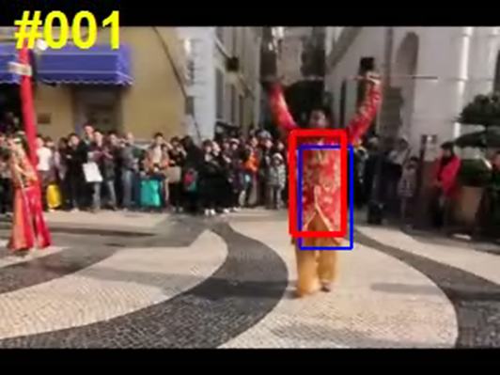
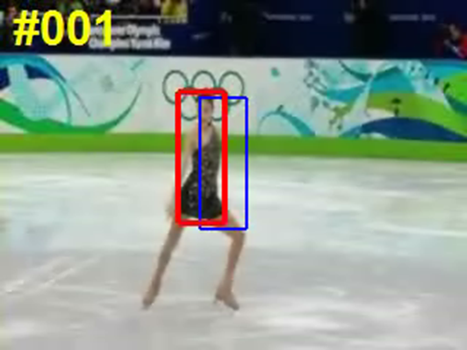
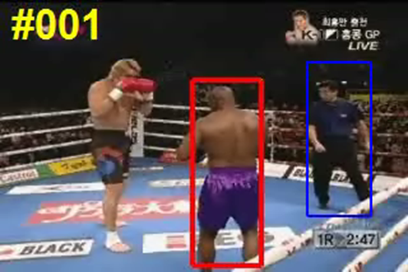
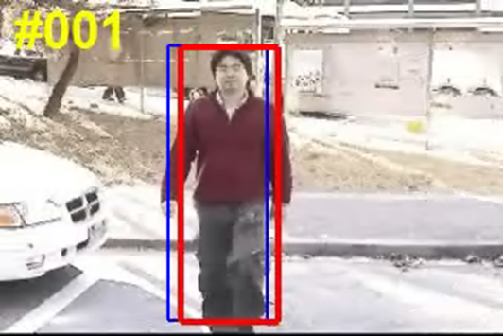
Qualitative Results
dance
skating
boxing
youngki
OURS
WLMC
OTLE
FRAG
SCM
L1APG

Slide 31
Quantitative Results
Center location error
 | FRAG | L1APG | CXT | ASLA | SCM | Struck | TLD | WLMC | OTLE | OMA | TST
campus | 3.3 | 16.1 | 33.4 | 12.2 | 12.2 | 83.1 | 46.7 | 13.5 | 5.8 | 3.2 | 1.4
TUD | 17.3 | 7.4 | 36.4 | 72.6 | 12.2 | 54.4 | 18.9 | 68.2 | 27.3 | 4.4 | 4.1
sunshade | 35.8 | 42.8 | 30.6 | 37.2 | 44.9 | 3.9 | 19.9 | 61.1 | 9.1 | 88.1 | 5.3
bike | 104.2 | 39.3 | 22.2 | 88.6 | 13.6 | 8.4 | 16.9 | 34.4 | 20.1 | 17.7 | 15.6
jumping | 21.8 | 3.2 | 12.6 | 49.0 | 3.1 | 3.3 | 11.7 | 127.6 | 20.2 | 3.4 | 2.8
tennis | 67.4 | 84.9 | 129.8 | 67.2 | 65.9 | 109.5 | 64.5 | 30.9 | 36.2 | 6.9 | 5.6
boxing | 80.0 | 117.4 | 137.3 | 137.3 | 96.0 | 122.7 | 73.3 | 11.7 | 41.6 | 10.5 | 10.6
youngki | 97.5 | 144.1 | 68.1 | 144.1 | 115.0 | 115.1 | 60.2 | 16.0 | 15.7 | 11.4 | 13.5
skating | 35.4 | 143.9 | 41.5 | 45.2 | 49.4 | 23.8 | 35.3 | 14.7 | 18.3 | 8.0 | 6.1
dance2 | 132.4 | 167.2 | 176.8 | 176.8 | 208.0 | 107.1 | 105.0 | 39.7 | 118.8 | 15.1 | 18.6
Bounding box overlap ratio
 | FRAG | L1APG | CXT | ASLA | SCM | Struck | TLD | WLMC | OTLE | OMA | TST
campus | 0.77 | 0.52 | 0.56 | 0.63 | 0.62 | 0.24 | 0.50 | 0.52 | 0.72 | 0.78 | 0.86
TUD | 0.59 | 0.85 | 0.51 | 0.30 | 0.67 | 0.30 | 0.67 | 0.38 | 0.49 | 0.82 | 0.80
sunshade | 0.33 | 0.32 | 0.49 | 0.43 | 0.45 | 0.78 | 0.57 | 0.24 | 0.60 | 0.29 | 0.70
bike | 0.08 | 0.18 | 0.39 | 0.16 | 0.46 | 0.54 | 0.45 | 0.39 | 0.27 | 0.40 | 0.56
jumping | 0.31 | 0.77 | 0.40 | 0.20 | 0.76 | 0.75 | 0.56 | 0.07 | 0.26 | 0.74 | 0.79
tennis | 0.11 | 0.29 | 0.08 | 0.12 | 0.11 | 0.28 | 0.10 | 0.43 | 0.33 | 0.63 | 0.74
boxing | 0.22 | 0.13 | 0.01 | 0.03 | 0.13 | 0.04 | 0.21 | 0.65 | 0.38 | 0.70 | 0.71
youngki | 0.19 | 0.02 | 0.38 | 0.12 | 0.13 | 0.09 | 0.24 | 0.62 | 0.54 | 0.62 | 0.56
skating | 0.25 | 0.02 | 0.25 | 0.13 | 0.20 | 0.40 | 0.33 | 0.46 | 0.41 | 0.42 | 0.55
dance2 | 0.14 | 0.02 | 0.08 | 0.10 | 0.07 | 0.08 | 0.07 | 0.45 | 0.30 | 0.52 | 0.52

Slide 32
Summary
Tree-structured graphical model for tracking
More general than chain model and blind model averaging
Joint optimization of tree-learning and tracking
Based on MCMC sampling technique
Hierarchical tracking
Based on semi-supervised manifold alignment
1
1
2
3
4
5
6
1
3
6
2
5
4
3
5
2
6
4

