Slide 1
Orderless Tracking through Model-Averaged Posterior Estimation
Seunghoon Hong* Suha Kwak Bohyung Han
Computer Vision Lab.
Dept. of Computer Science and Engineering
POSTECH
Notes:
Videos (qualitative results) are excluded from this file.

Slide 2
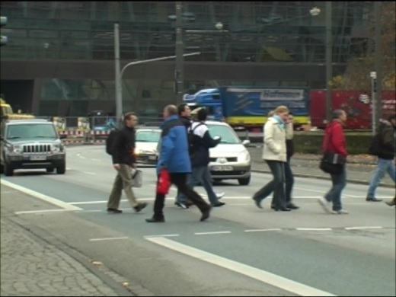
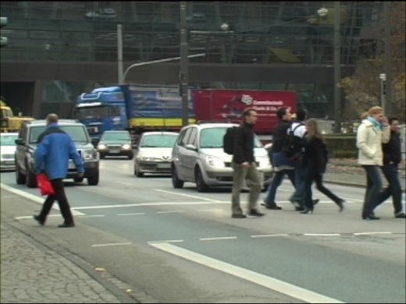
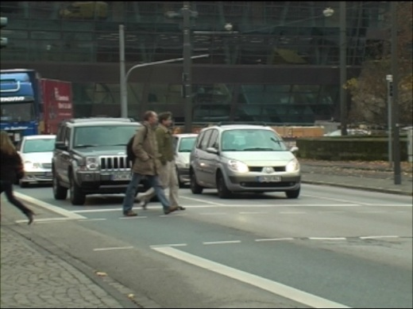
Goal of Visual Tracking
Robust estimation of accurate target states through out an input video

Slide 3
Bayesian Tracking Approach
Posterior estimation for the target states
$$arg\max_{X_{t}}$$
$$P\left(X_{t}|Z_{1:t}\right)$$
Image Space
s
s
s
State Space
x
x
x
y
y
y
$$X=\{x,y,s\}$$

Slide 4
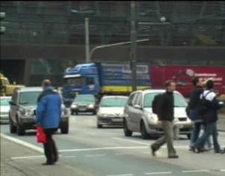
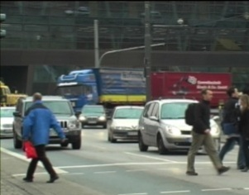
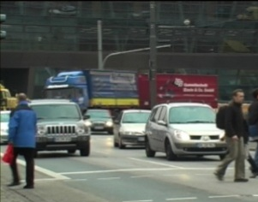
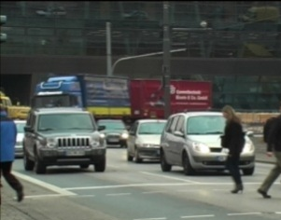
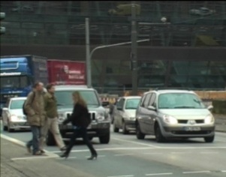
Conventional Tracking Approaches
Sequential estimation of the target posteriors by a temporal order of frames
1
29
34
43
50
92

Slide 5
Our Approach
Tracking easy-to-track frames first by searching a suitable order of frames
1
29
34
43
50
92

Slide 6
Overall Framework
$k^{th}$ Iteration
1
2
3
…
…
Tracked frames $𝓣_{k−1}$
Remaining frames $𝓡_{k−1}$

Slide 7
Challenges
$k^{th}$ Iteration
1
2
3
…
…
Tracked frames $𝓣_{k−1}$
Remaining frames $𝓡_{k−1}$
Challenge 1 : How to propagate posterior between arbitrary frames ?
Challenge 1 : How to propagate posterior between arbitrary frames ?
Challenge 2 : How to select the easiest frame to track next ?

Slide 8
Density Propagation
Density propagation by Bayesian Model Averaging
$$Ω_{\{1\}}$$
$$x_{1}$$
$$x_{t_{4}}$$
$$Ω_{\{1,5\}}$$
$$x_{1}$$
$$x_{5}$$
$$x_{t_{4}}$$
$$x_{1}$$
$$x_{5}$$
$$x_{3}$$
$$x_{t_{4}}$$
$$Ω_{\{1,3\}}$$
$$x_{1}$$
$$x_{3}$$
$$x_{t_{4}}$$
: tracked frames
: a remaining frame
$$Ω_{\{1,5,3\}}$$
$$x_{1}$$
$$x_{5}$$
$$x_{3}$$
$$x_{t_{4}}$$
Posterior propagation along each chain model
Prior for each chain model
$$P\left(x_{t_{k}}|Z_{t_{1},…,t_{k−1}}\right)=\sum_{𝒮_{t}⊆𝒯_{k−1}}{P\left(x_{t_{k}}|Z_{𝒮_{t_{k}}},Ω_{𝒮_{t_{k}}}\right)}P\left(Ω_{𝒮_{t_{k}}}\right)$$
$$\tilde{P}\left(x_{t_{k}}\right)∝\frac{1}{k−1}\sum_{t∈𝒯_{k−1}}{P\left(Z_{t_{k}} | x_{t_{k}}\right)\int{P\left(x_{t_{k}} | x_{t}\right)\tilde{P}\left(x_{t}\right)dx_{t}}}$$

Slide 9
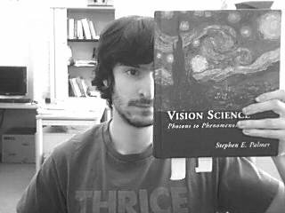
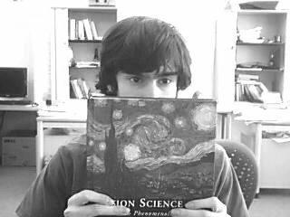
$$P\left(Z_{t_{k}} | x_{t_{k}}\right)\int{P\left(x_{t_{k}} | x_{t}\right)\tilde{P}\left(x_{t}\right)dx_{t}}$$
$$x_{1}$$
…
$$x_{t}$$
$$x_{t_{k}}$$
$$≈\sum_{x_{t}^{i}∈𝕊_{t}}{P\left(Z_{t_{k}} | x_{t_{k}}\right)P\left(x_{t_{k}} | x_{t}^{i}\right)}$$
Patch matching^{[1]}
and voting process
Tracked frame $t$
Remaining frame $t_{k}$
Matched patches
Vote to center
Sample 1
Voting map by sample 1
[1] S. Korman and S. Avidan. Coherency sensitive hashing. In ICCV, 2011

Slide 10
$$\sum_{x_{t}^{i}∈𝕊_{t}}{P\left(Z_{t_{k}} | x_{t_{k}}\right)P\left(x_{t_{k}} | x_{t}^{i}\right)}$$
$$x_{1}$$
…
$$x_{t}$$
$$x_{t_{k}}$$
Aggregate all voting maps from samples, and generate propagated posterior.
Sample 2
Sample 3
Sample 4
Sample ${|𝕊}_{t}|$
Posterior $t$
…
votes $t_{k}$
Propagated posterior along a single chain model
$$p\left(x_{t_{k}}|Z_{𝒮_{t_{k}}},Ω_{𝒮_{t_{k}}}\right)$$

Slide 11
Identifying Subsequent Frame
Which frame is preferred to track next?
$$arg\max_{X_{t}} P\left(X_{t}|Z_{1:t}\right)$$
Remaining frame #1
Remaining frame #2
Remaining frame #3
s
s
s
x
x
x
y
y
y
CLEAR
Unique and certain mode in distribution
AMBIGUOUS
Unique but uncertain mode in distribution
AMBIGUOUS
uncertain and multi-modal distribution

Slide 12
Identifying Subsequent Frame
Measuring uncertainty by entropy
$$s$$
$$y$$
$$x$$
Target density
Divide state space into regular grid blocks
Marginalize the density per block
Vectorize blocks and measure entropy $ℋ$

Slide 13
Identifying Subsequent Frame
$$ℋ\left(x_{r}\right)=\sum_{s}{\sum_{m=1}^{M}{−P\left(B_{r}^{m,s}\right)\log{P\left(B_{r}^{m,s}\right)}}}$$
1. Calculate entropy for all remaining frames
2. Select the subsequent frame with minimum entropy
$$t_{k}=\text{arg}\min_{r}{ℋ\left(x_{r}\right)},$$
$$r∈ℛ_{k−1}$$
3. Infer the target location in the newly tracked frame
$$X_{t_{k}}^{∗}=arg\max_{x_{t_{k}}}{P(x_{t_{k}})}$$
4. Update the lists of tracked and remaining frames
$$𝒯_{k}{=𝒯}_{k−1}∪\{t_{k}\}$$
$$ℛ_{k}=ℛ_{k−1}\backslash \{t_{k}\}$$

Slide 14
Identified Tracking Order
Occlusions
Identified tracking order
Temporal order

Slide 15
Identified Tracking Order
Shot changes
Identified tracking order
Temporal order

Slide 16
Computational Complexity
The main drawback is computational cost.
It needs to perform density estimation $\left(\begin{matrix}N \\ 2\end{matrix}\right)$ times.
Computational cost : $O(N^{2})$
It can be reduced by a Hierarchical approach.
Track $k$ key frames first, and propagate posteriors to non-key frames.
Computational cost : $O(kN)$

Slide 17
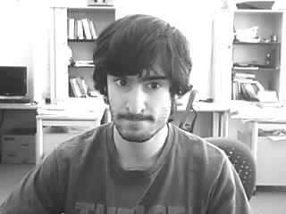
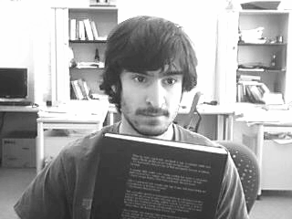
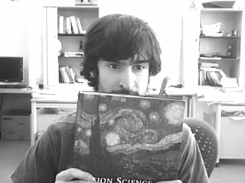
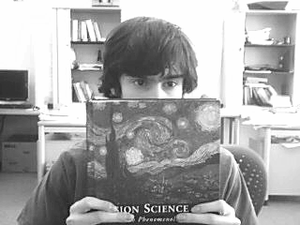
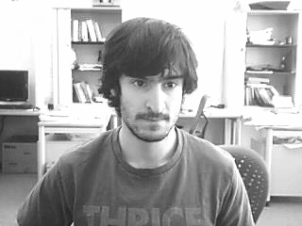
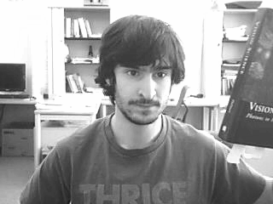
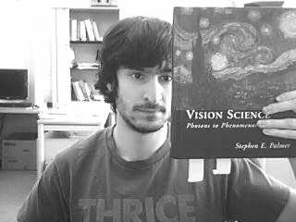
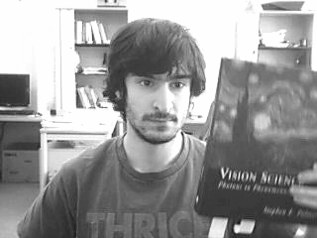
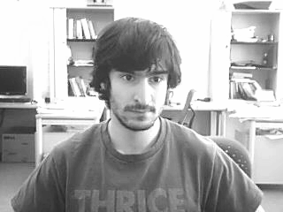
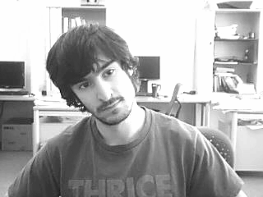
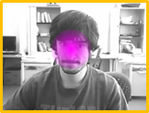
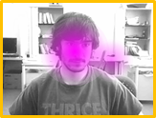
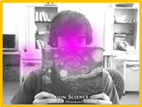
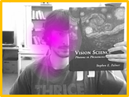
Efficient Hierarchical Approach
Key frame selection
Tracking key frames by the proposed tracker
Propagate posteriors to the remaining frames

Slide 18
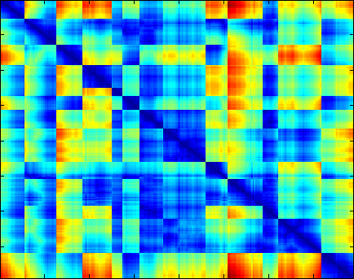
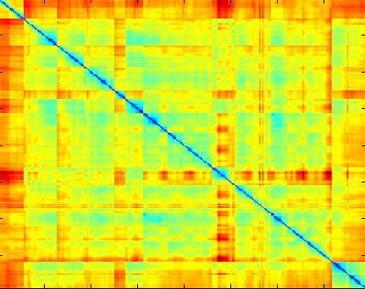
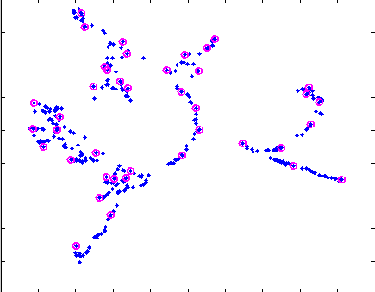
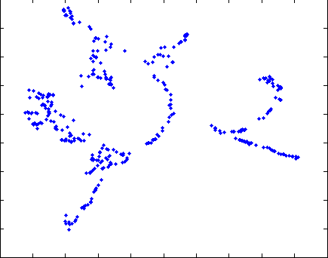
Key-frame Selection
ISOMAP
A metric space, $E$
Geodesic distances from a sparse nearest neighbor graph
Dissimilarities between all pairs of frames
$k$ most representative frames obtained by solving a $k$-center problem
Embedded frames
$$\frac{1}{n_{1}}\sum_{P∈I_{1}}{\min_{Q∈I_{2}}{d(P,Q)}}+\frac{1}{n_{2}}\sum_{Q∈I_{2}}{\min_{P∈I_{1}}{d(P,Q)}}$$
$$𝒦^{∗}=\arg{\min_{𝒦⊆ℱ}{\max_{v∈ℱ}{\min_{u∈𝒦}{d_{E}(u,v)}}}}$$

Slide 19
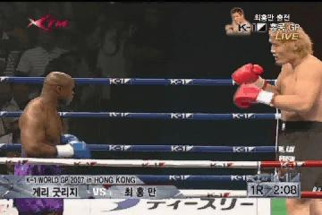
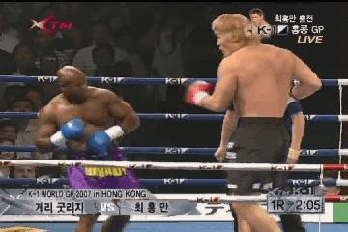
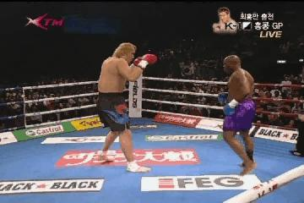
Posterior Propagation from Key to Non-key frames
From key frames $𝒦$ to a non-key frame $u$
$$\tilde{P}\left(x_{u}\right)=\sum_{v∈𝒦}{P\left(x_{u}|Z_{𝒦},p_{v→u}\right)}P\left(p_{v→u}\right)$$
Weight for the chain model
$v→u$
Density propagation by
Patch-matching and voting
Key frames $𝒦$
Non-key frame $u$
$$d_{E}\left(v_{1},u\right)$$
$$v_{1}$$
$$d_{E}\left(v_{2},u\right)$$
$$d_{E}\left(v_{1},u\right)≪d_{E}\left(v_{2},u\right)$$
$$P\left(p_{v_{1}→u}\right)≫P\left(p_{v_{2}→u}\right)$$
$$v_{2}$$
Frames embedded on $E$
$$⋮$$

Slide 20
Quantitative Results
Center location error
 | IVT | SCM | L1APG | ASLSA | FRAG | WLMC | OTLE | OMA | SMA
animal | 10.6 | 16.6 | 48.8 | 179.6 | 94.1 | 64.8 | 19.4 | 7.7 | 7.4
TUD | 12.6 | 12.2 | 7.4 | 67.2 | 17.3 | 68.2 | 27.4 | 4.4 | 5.9
campus | 38.7 | 12.2 | 16.1 | 12.2 | 3.3 | 13.5 | 5.8 | 3.2 | 7.0
accident | 27.6 | 3.0 | 20.3 | 2.9 | 7.4 | 12.2 | 9.1 | 2.6 | 6.5
tennis | 68.7 | 65.9 | 85.0 | 68.8 | 67.4 | 31.0 | 37.0 | 6.9 | 11.9
boxing | 128.1 | 96.0 | 114.6 | 106.8 | 80.0 | 11.7 | 41.7 | 10.5 | 22.6
youngki | 95.2 | 115.0 | 137.9 | 151.8 | 97.5 | 16.0 | 15.7 | 11.4 | 14.0
skating | 77.8 | 49.4 | 143.9 | 22.8 | 35.4 | 14.7 | 18.3 | 8.0 | 10.8
psy | 156.5 | 212.3 | 71.8 | 146.8 | 95.2 | 66.0 | 61.2 | 15.0 | 21.9
Dance2 | 283.9 | 208.0 | 113.9 | 118.1 | 132.4 | 39.7 | 118.8 | 15.1 | 19.7
Bounding box overlap ratio
 | IVT | SCM | L1APG | ASLSA | FRAG | WLMC | OTLE | OMA | SMA
animal | 0.60 | 0.55 | 0.40 | 0.04 | 0.08 | 0.31 | 0.48 | 0.71 | 0.71
TUD | 0.65 | 0.67 | 0.85 | 0.32 | 0.59 | 0.38 | 0.48 | 0.82 | 0.75
campus | 0.56 | 0.62 | 0.52 | 0.63 | 0.77 | 0.52 | 0.72 | 0.78 | 0.67
accident | 0.58 | 0.87 | 0.69 | 0.84 | 0.60 | 0.57 | 0.59 | 0.85 | 0.76
tennis | 0.06 | 0.11 | 0.29 | 0.12 | 0.11 | 0.43 | 0.31 | 0.63 | 0.56
boxing | 0.05 | 0.13 | 0.07 | 0.11 | 0.22 | 0.65 | 0.38 | 0.70 | 0.51
youngki | 0.09 | 0.13 | 0.02 | 0.06 | 0.19 | 0.62 | 0.54 | 0.62 | 0.54
skating | 0.01 | 0.20 | 0.02 | 0.29 | 0.25 | 0.46 | 0.41 | 0.42 | 0.37
psy | 0.07 | 0.07 | 0.02 | 0.17 | 0.23 | 0.39 | 0.40 | 0.63 | 0.57
Dance2 | 0.03 | 0.07 | 0.10 | 0.11 | 0.14 | 0.45 | 0.30 | 0.52 | 0.50

Slide 21
Summary
Non-temporal offline tracking algorithm
Actively identifying a suitable tracking order
Tracking by Bayesian model averaging
Robust to intermediate failures
Hierarchical tracking
Reducing empirical processing time significantly

